Slide 1
Daily Review
The average is a single number that summarizes or represents a list of numbers.
We calculate it by adding all the numbers in a list and then dividing by the total number of values in the list.
For example (T1 + T2 + T3)/3
Calculate the average of the following:
 | Plant Height (cm)
Amount of fertiliser (ml/L) | Trial 1 | Trial 2 | Trial 3 | Average
0.1 | 5 | 6 | 7
1 | 6.1 | 5.9 | 12
10 | 8 | 8.7 | 10.3
a)
b)
c)
Notes:
45 s → share → popsticks

Slide 2
Forms of Energy Year 8 Science

Slide 3
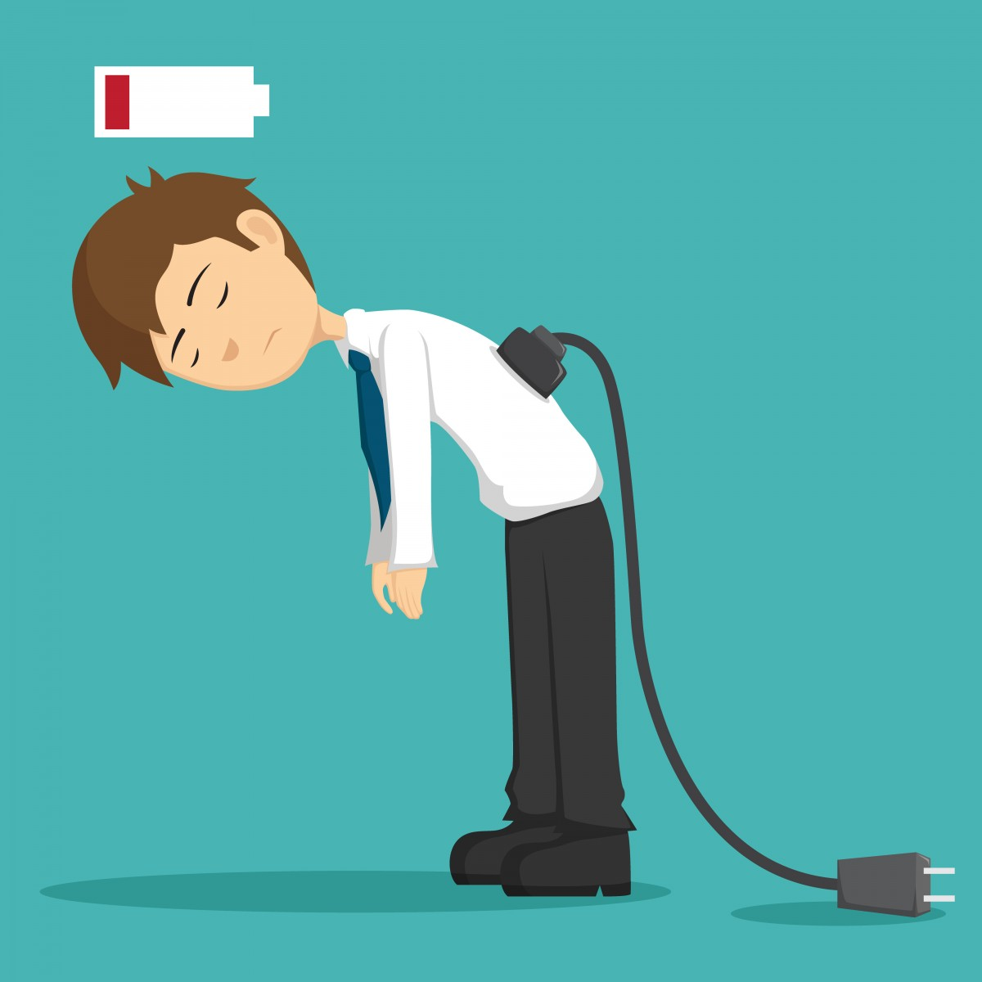
Learning Objective
CFU
What are we going to learn?
Identify and describe different forms of energy.
Activate Prior Knowledge
Plants and animals use energy every day in order to function.
Think, Pair, Share: How do our bodies use energy in everyday life?
What other sources of energy do we use on a daily basis?

Slide 4
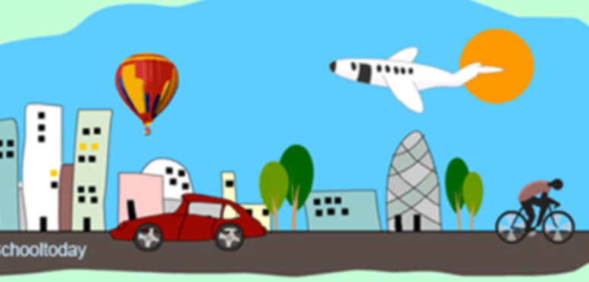
Concept Development
CFU 1
What is energy and what does it allow things to do?
CFU 2
How can energy be detected?
What is Energy?
Energy:
is the ability to make something move or change.
can’t be seen or weighed, but you can observe what it does.
can’t be created or destroyed, only transferred or transformed.
CFU 3
On your whiteboard, give two examples of things that you would need energy for.
Vocabulary
energy (noun) the ability to make something move or change

Slide 5
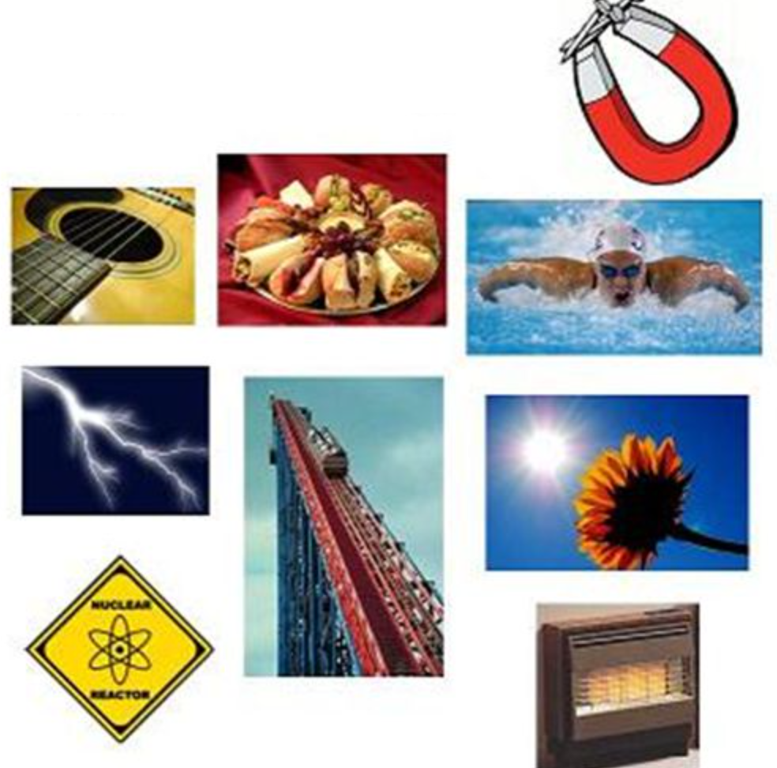
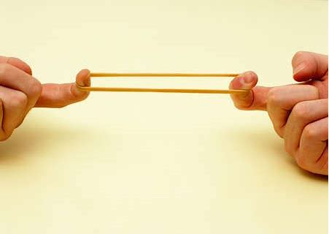
Concept Development
CFU 1
How many different forms of energy are there?
CFU 2
Think, Pair, Share: Which pictures show: Elastic energy? Sound energy? Light energy?
Forms of Energy
There are many different forms of energy:
Kinetic energy
Heat energy
Light energy
Sound energy
Electrical energy
Elastic energy
Gravitational energy
Chemical energy
Nuclear energy
…and many more!

Slide 6
Concept Development
Forms of Energy
A simple phrase can be used to remember the nine forms of energy. Copy this one into your science workbook, or make up your own.
Not
Every
Clever
Guy/Girl
Knows
Spiders
Have
Eight
Legs
Nuclear
Electrical
Chemical
Gravitational
Kinetic
Sound
Heat
Elastic
Light

Slide 7
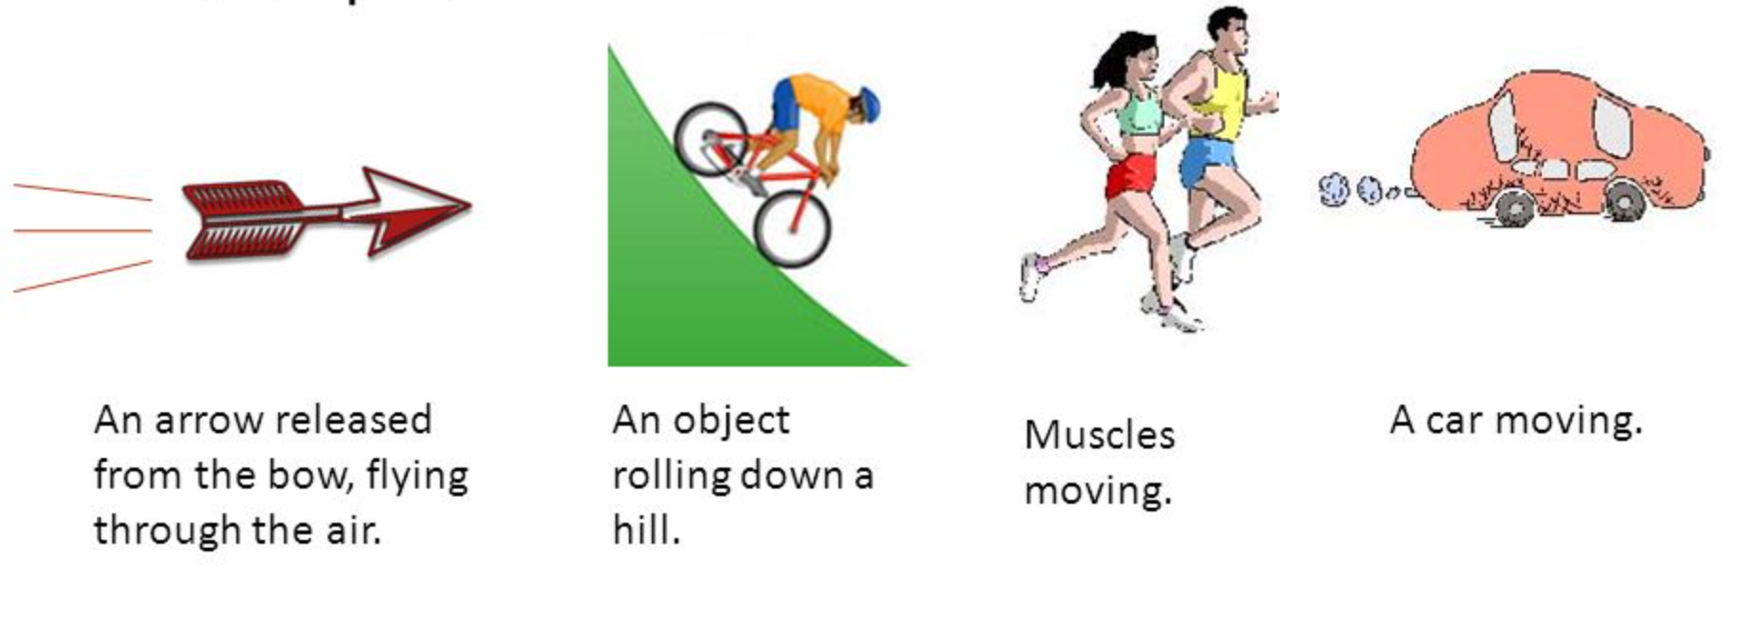
Concept Development
CFU 1
True or False? A car stopped at a red traffic light has kinetic energy.
Kinetic Energy
Kinetic energy is the energy of movement.
The faster an object moves, the more kinetic energy it has.
Examples:
CFU 2
Which has more kinetic energy – a car travelling at 10 km/h or the same car travelling at 50 km/h? Explain your choice.

Slide 8
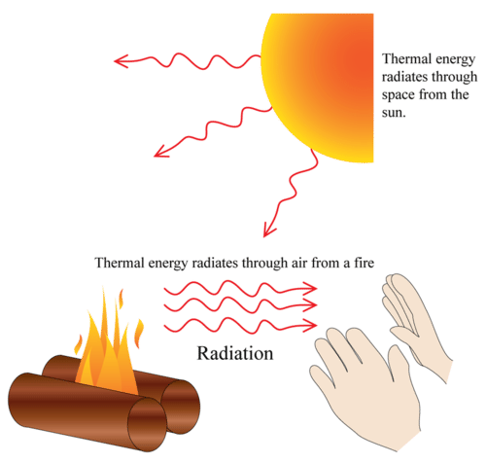
Concept Development
CFU 1
What is heat energy?
CFU 2
True or False? Boiling water has less heat energy than cold water.
Heat Energy
Heat energy is energy that can warm things up.
It is the energy that an object has because of the movement of its particles: more movement results in more heat.
Temperature is a measure of the average kinetic (movement) energy of these particles.
Examples:

Slide 9





Concept Development
CFU 1
What is light energy?
CFU 2
Think, Pair, Share: Name two other objects that produce light energy.
Light Energy
Light is the energy that is produced by luminous objects, and enables us to see.
It can be reflected by a mirror or lens, or absorbed by an object.
Examples:
Vocabulary
luminous (adjective) produces light

Slide 10


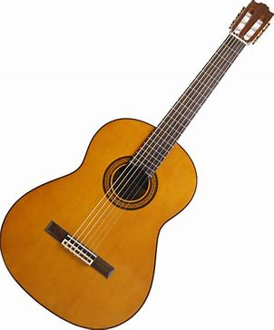


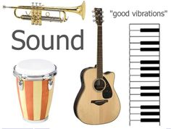
Concept Developmnt
CFU 1
Think, Pair, Share: Name two objects which produce sound energy.
Sound Energy
Sound energy is produced by objects vibrating.
A vibrating object causes the air around it to vibrate. Your ears and brain interpret the vibrating of the air as sound.
Bigger vibrations have more sound energy and are interpreted as louder sounds.
CFU 2
How do we hear sounds?
Examples:

Slide 11
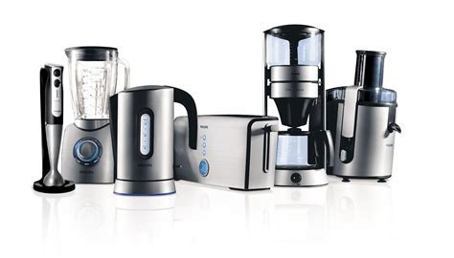
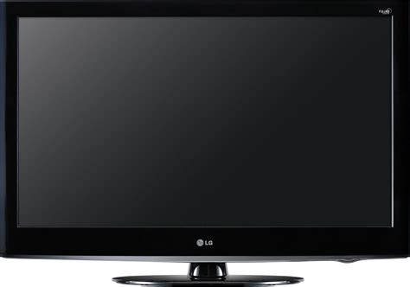
Concept Development
CFU 1
What is electrical energy supplied by?
Electrical Energy
Electrical energy is supplied by an electric current, which is the movement of charged particles.
In most electronic devices, these particles are electrons (which have a negative charge), which move through wires.
Electrical energy comes from power stations, solar cells and batteries.
CFU 2
What is an electric current? Use an example as part of your answer.
CFU 3
Challenge: Name one similarity and one difference between lightning and the electricity that powers your lights at home.
Examples:

Slide 12

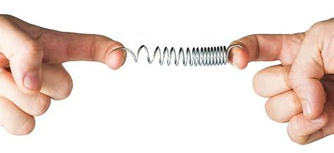
Concept Development
CFU 1
What is elastic energy?
Elastic Energy
Elastic energy is stored by objects that are stretched, compressed, twisted, flexed or wound up.
The energy is released when the object is let go and returns to its original shape.
CFU 2
True or False? Elastic energy is the energy stored as a result of an object changing shape.
Examples:

Slide 13
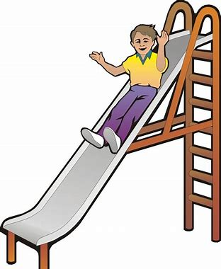
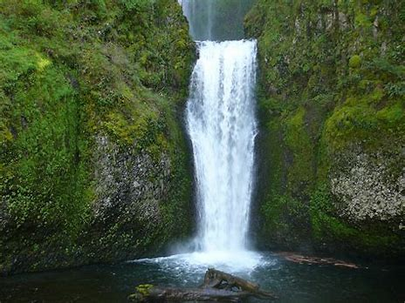
Concept Development
CFU 1
True or False? A rock on a cliff face has gravitational energy because it can fall to the bottom of the cliff.
Gravitational Energy
Gravitational energy is stored by objects as they are moved away from the Earth (or another object with mass).
The greater the height off the ground, the more gravitational energy an object has.
CFU 2
Which has more gravitational energy – a person on the 1st floor of a building or a person on the roof?
Examples:
Water at the top of a waterfall Person at the
top of a slide

Slide 14
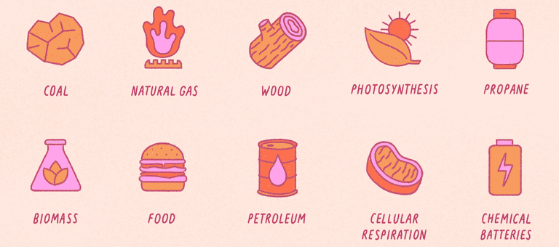
Concept Development
CFU 1
Think, Pair, Share: Name two objects with chemical energy.
Chemical Energy
Chemical energy is stored in the chemical bonds of substances, and can be released through chemical reactions.
CFU 2
True or False? Chemical energy is released by your body when you digest food.
Examples:

Slide 15
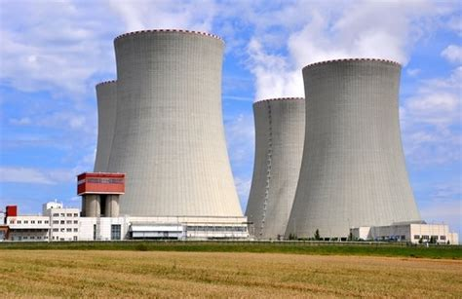
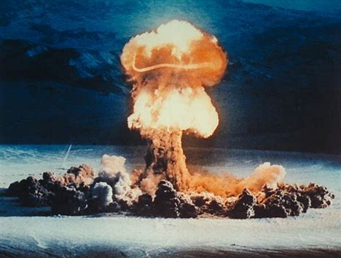
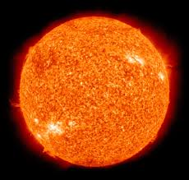
Concept Development
CFU 1
What is nuclear energy?
CFU 2
Think, Pair, Share: Name two examples of nuclear energy.
Nuclear Energy
Nuclear energy is stored in the bonds within the atoms that make up all matter.
Some of this energy is released when atoms are split apart (nuclear fission) or joined together (nuclear fusion).
Splitting a single atom can release enough energy to split other atoms, which then split other atoms, and so on. This is called a chain reaction, and can add up to an enormous amount of energy.
Examples:

Slide 16
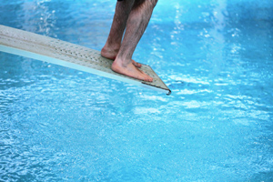
Skill Development / Guided Practice
Describing energy types
Identify two or three main types of energy used or released by the object Write a full sentence response: The main energy types used or released by a _______ are _________, ________ and _______ energy.
What types of energy are used or released by a diving board?
The main energy types used or released by a diving board are elastic, kinetic and sound.
Reminder
Kinetic: Movement Heat: Warms things up Light: Brightness / lets us see Sound: Vibrating objects / can be heard Electrical: Movement of electric charges Elastic: Stored in compressed / stretched objects Gravitational: Stored in objects high up Chemical: Stored in chemical bonds Nuclear: Stored inside atoms

Slide 17

Skill Development / Guided Practice
Describing energy types
Identify two or three main types of energy used or released by the object Write a full sentence response: The main energy types used or released by a _______ are _________, ________ and _______ energy.
What types of energy are used or released by a mobile phone?
The main energy types used or released by a mobile phone are chemical, electrical and light.
Reminder
Kinetic: Movement Heat: Warms things up Light: Brightness / lets us see Sound: Vibrating objects / can be heard Electrical: Movement of electric charges Elastic: Stored in compressed / stretched objects Gravitational: Stored in objects high up Chemical: Stored in chemical bonds Nuclear: Stored inside atoms

Slide 18
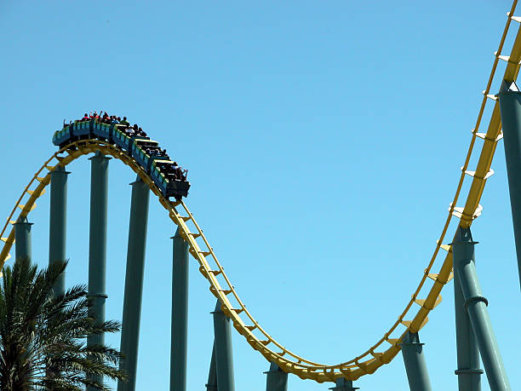
Skill Development / Guided Practice
Describing energy types
Identify two or three main types of energy used or released by the object Write a full sentence response: The main energy types used or released by a _______ are _________, ________ and _______ energy.
What types of energy are used or released by a rollercoaster?
The main energy types used or released by a rollercoaster are kinetic, gravitational and sound energy.
Reminder
Kinetic: Movement Heat: Warms things up Light: Brightness / lets us see Sound: Vibrating objects / can be heard Electrical: Movement of electric charges Elastic: Stored in compressed / stretched objects Gravitational: Stored in objects high up Chemical: Stored in chemical bonds Nuclear: Stored inside atoms

Slide 19
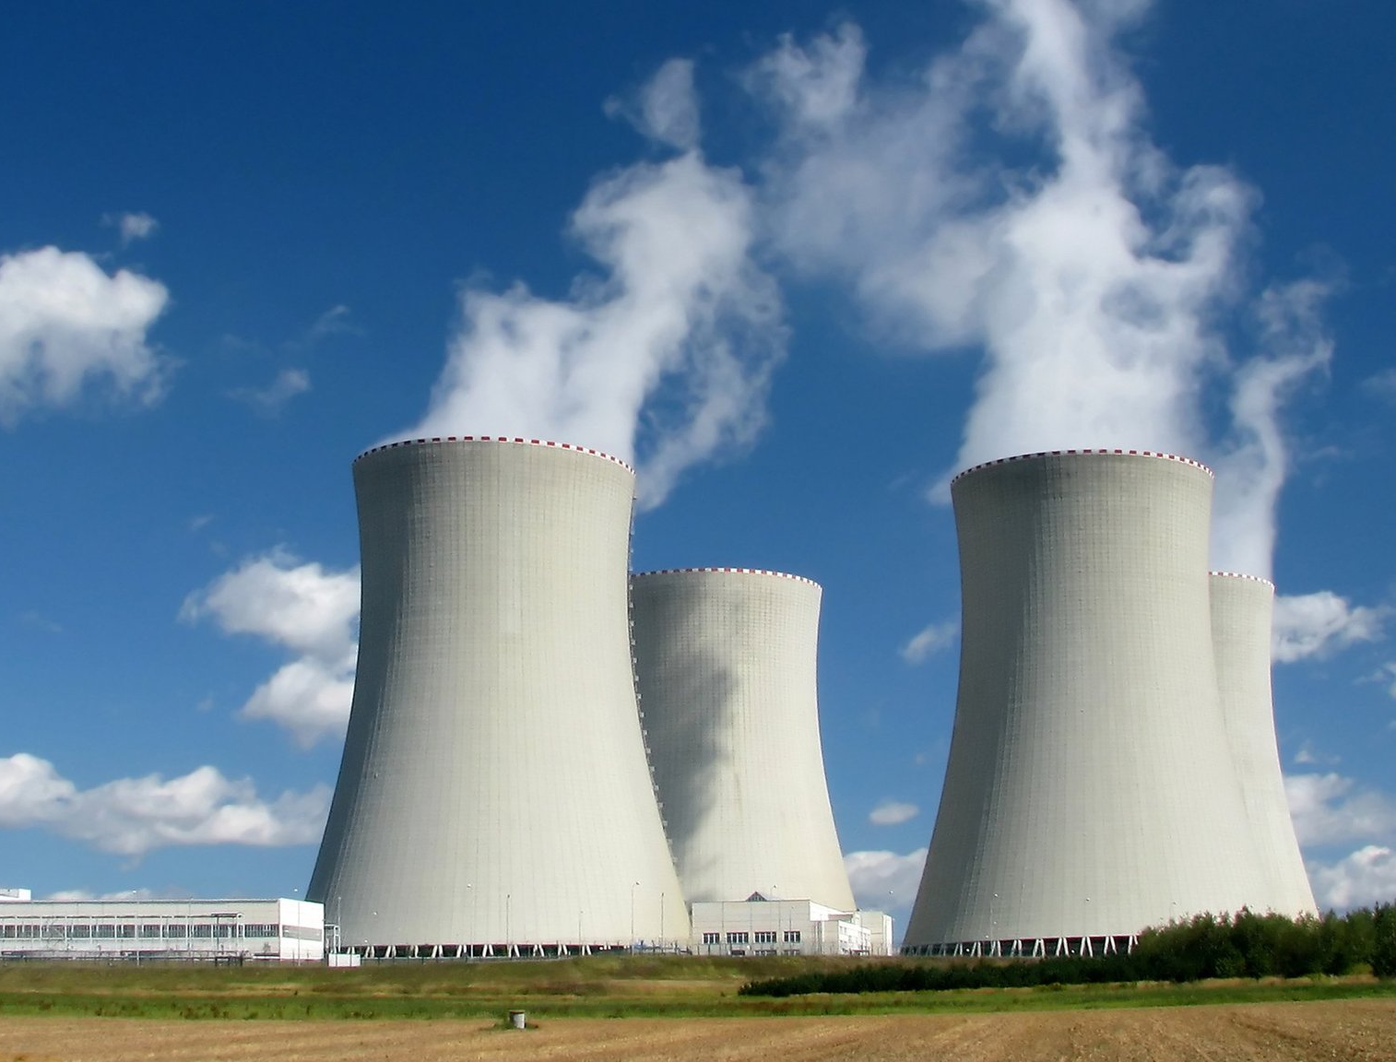
Skill Development / Guided Practice
Describing energy types
Identify two or three main types of energy used or released by the object Write a full sentence response: The main energy types used or released by a _______ are _________, ________ and _______ energy.
What types of energy are used or released by a nuclear power plant?
The main energy types used or released by a nuclear power plant are nuclear, electrical and heat energy.
Reminder
Kinetic: Movement Heat: Warms things up Light: Brightness / lets us see Sound: Vibrating objects / can be heard Electrical: Movement of electric charges Elastic: Stored in compressed / stretched objects Gravitational: Stored in objects high up Chemical: Stored in chemical bonds Nuclear: Stored inside atoms

Slide 20
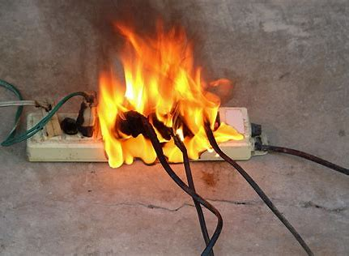
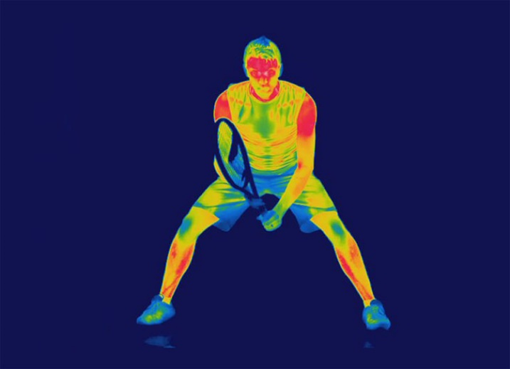
Relevance
Why does energy matter?
Every movement and change you see around you is caused by energy. Your bodies, vehicles and electronic devices – and just about everything else – use and produce all sorts of different types of energy all the time. Understanding it will help you to understand why these changes happen and how these things work.
Too much energy in the wrong place can be dangerous – knowing how different types of energy work will help you stay safe and make informed decisions.

Slide 21
Skill Closure
Match the energy form with its definition on your whiteboard.
Energy Form Definition
1 Heat A Energy that travels through the air as vibrations
2 Light B Energy that can warm things up
3 Sound C Energy carried by tiny electrical charges through a wire
Electrical D Energy carried by any moving object
Kinetic E Energy given off by bright objects, which allows us to see

Slide 22
Independent Practice
Collect ‘Forms of Energy’ worksheet 1 – Complete the descriptions of each energy type by matching the statements in column 1, column 2 and column 3. You can do the second page now or save it for revision later.
Collect ‘Forms of Energy’ worksheet 2 – look at each of the pictures and write down which forms of energy they have (most have more than one).

